Slide 1
Federal funding & Massachusetts
A Better City conversation
Quentin Palfrey, Director, Federal Funds and Infrastructure Office
March 31, 2025

Slide 2
Agenda
Federal Outlook and Strategies for Competitiveness
About the Federal Funds and Infrastructure Office (FFIO)
FFIO’s Strategies for Ensuring Competitiveness
Project Focus: Allston Multimodal Project

Slide 3
About the Federal Funds and Infrastructure Office (FFIO)
Officially created by Executive Order No. 624, and tasked with implementing a whole-of-government to compete for federal funding by:
Leading bi-weekly meetings of the interagency Advisory Council on Federal Funds and Infrastructure
Identifying and tracking key federal funding opportunities and Massachusetts applications through the State Clearinghouse
Implementing the Federal Match legislation (Chapter 214 of the Acts of 2024)
Leading the Massachusetts Federal Funds Partnership and other meetings to support local governments in their applications for federal funding

Slide 4
Federal outlook and strategies for competitiveness
Evolving federal funds landscape

Slide 5
FFIO’s strategies for ensuring competitiveness

Slide 6
Local Government Engagement

Slide 7
The Partnership provides key federal grant information to the local governments of MA.
FFIO leads the monthly Massachusetts Federal Funds Partnership meeting. This forum delivers federal funding updates and offers a platform for addressing questions related to the many funding opportunities at the disposal of cities, towns and tribal organizations.
Massachusetts Federal funds partnership
Previous Federal Funds Partnership Meeting Tuesday, March 25th
    Project Prioritization for Effective Technical Assistance
    MBI Launchpad Program Presentation
Next Federal Funds Partnership Meeting Tuesday, April 29th

Slide 8
engagement with RPAs and federally recognized tribes
Previous Monthly Meeting with MARPA + Federally Recognized Tribes Friday, March 7th
    Project prioritization
    MBI Presentation
Next Monthly Meeting with MARPA + Federally Recognized Tribes Friday, April 4th
    Working with RPA’s and agencies to identify technical assistance gaps.

Slide 9
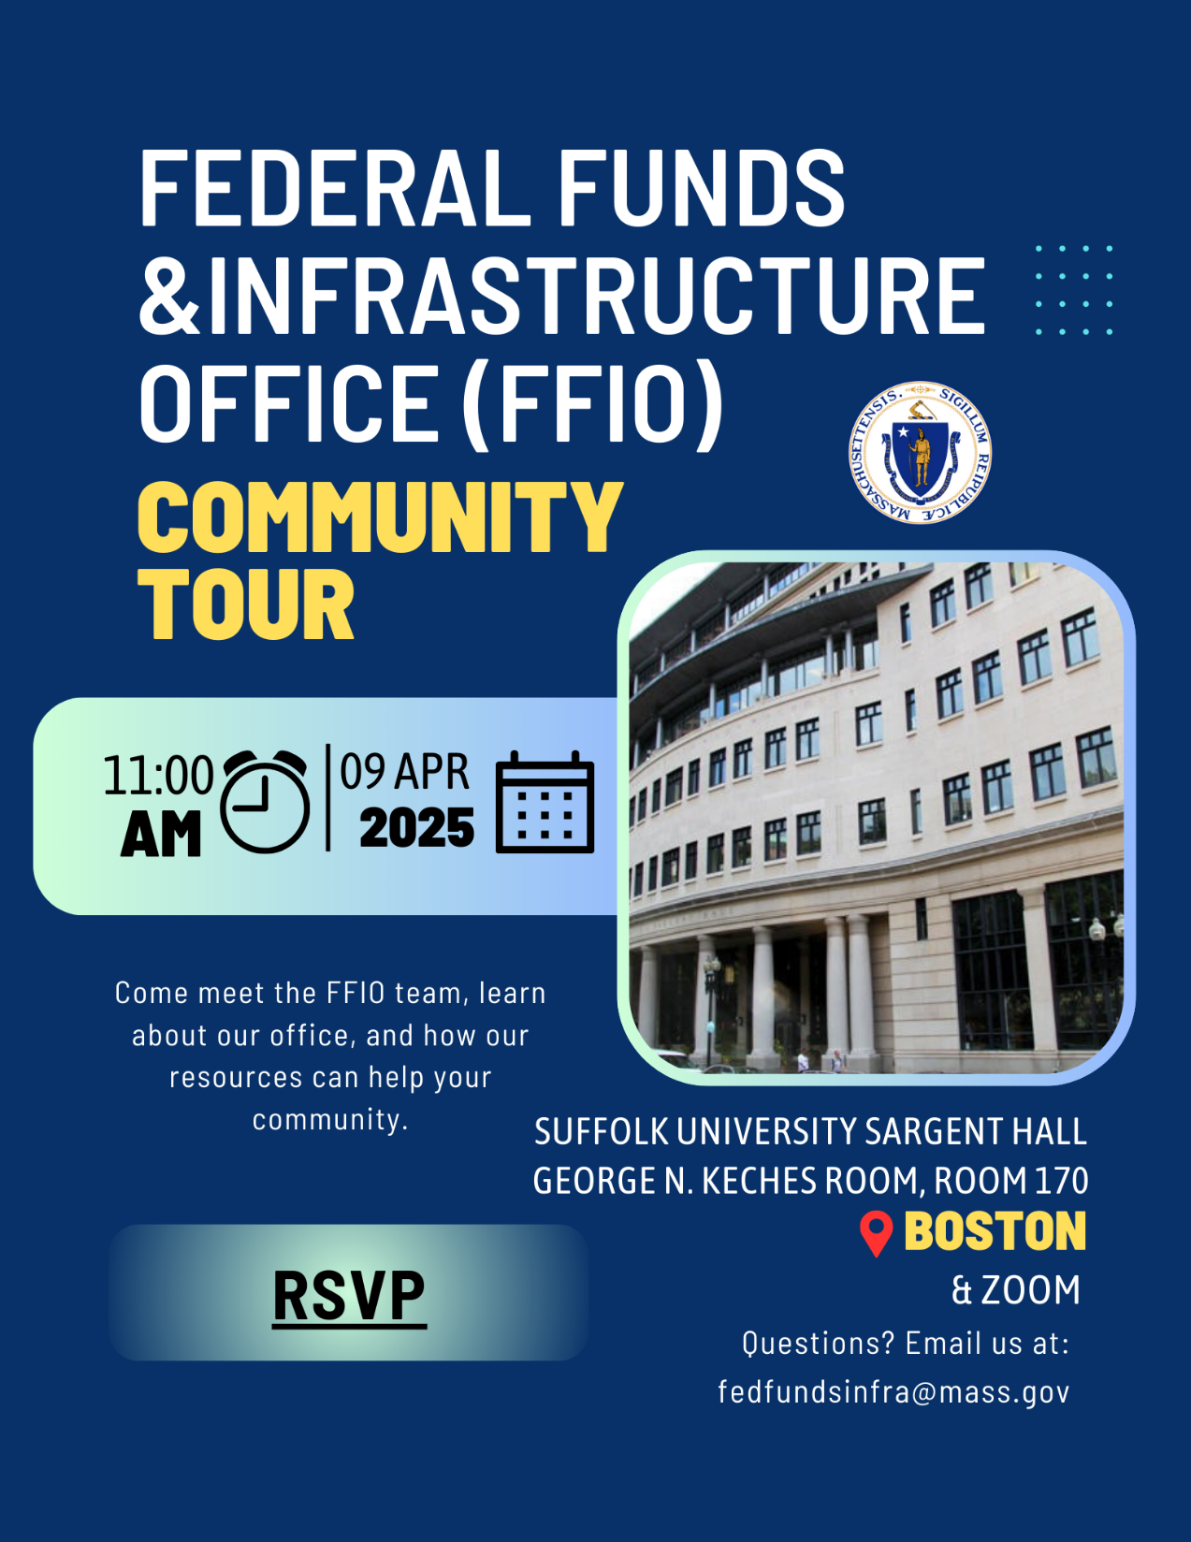


FFIO Community Tour
    INFORMATION SHARING: Provide information on federal grant application resources made available by the new legislation
    UNDERSTAND NEEDS AND PRIORITIES: Seek community input on priority projects seeking federal funding
    GATHER FEEDBACK: Solicit feedback on the Federal Funds Partnership and other FFIO processes
PITTSFIELD
BROCKTON
BOSTON
(April 9th)
HAVERHILL
WORCESTER

Slide 10
Federal Matching Funds Legislation

Slide 11
Massachusetts Federal match legislation
Matching Funds
Unlocks up to $750M for matching funds for federal programs
Eligible entities, including RPA’s can now apply for match via the FFIO Match Request Form
Learn more on the new Massachusetts Matching Funds Website
Other Financial Assistance for Municipalities
Allocates up to $50M in the form of grants, loans, or other financial assistance, which may be directed to municipalities.
Explore providing start-up capital for Direct Pay-eligible projects, etc.
Technical Assistance for Municipalities
Allocates up to $12M for technical support to munis for grant application development and implementation assistance for successful awards
Leverage existing municipal outreach (partnership meetings, upcoming community tour, etc.) to understand municipal needs

Slide 12
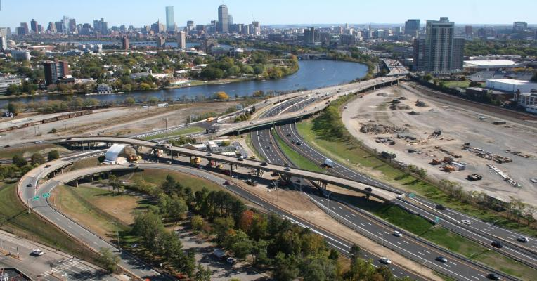
Project focus:
Allston multimodal project

Slide 13
Federal Funds
USDOT awarded $335 million through the Reconnecting Communities and Neighborhood Grant Program to replace the Allston Viaduct and create new and improved access to expanded waterfront parks and open space in Boston, as well awards for Haverhill, Lynn, Everett, Cambridge and Chelsea.
Recent Developments
MassDOT announced a monthly schedule of task force meetings, as well as the hiring of a meeting facilitator.
March 12 Allston Task Force Meeting for layover analysis (now posted on the project website).
MassDOT and MBTA continuing to discuss the layover analysis with other relevant stakeholders.
Agencies are continuing to assess A Better City’s proposal for an alternative construction approach to the Grand Junction Bridge closure.
Next Steps & Way Forward
Project Focus:
Allston multimodal project

Slide 14
Thank you!
If we are unable to get to your question today, please send it to us at FedFundsInfra@mass.gov.

